Slide 1




Python Introduction

Slide 2

Git, IDE & Python
Page 01

Slide 3
Content
Git
Python
Introduction to Version Control (Git):
Create and clone repository
Upload file to repository
Introduction to python:
Create your first program
Comments
Variables
Data types
Math Operations
Castings
IDE
Introduction to Integrated Development Environment (IDE):
What is IDE
VS Code
Page 02

Slide 4
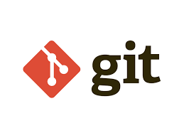
Git
Git is a distributed version-control system for tracking changes in source code during software development.
It is designed for coordinating work among programmers, but it can used to track in any set of files. Its goals include speed, data integrity, and support for distributed, non-linear workflows.
Page 03

Slide 5
Git Command
git clone [url]
Clone (download) a repository that already exists on GitHub, including all of the files, branches, and commits.
git add [file]
Snapshots the file in preparation for versioning.
git commit -m “[descriptive message]”
Records file snapshots permanently in version history
git push
Uploads all local branch commits to GitHub
Page 04

Slide 6
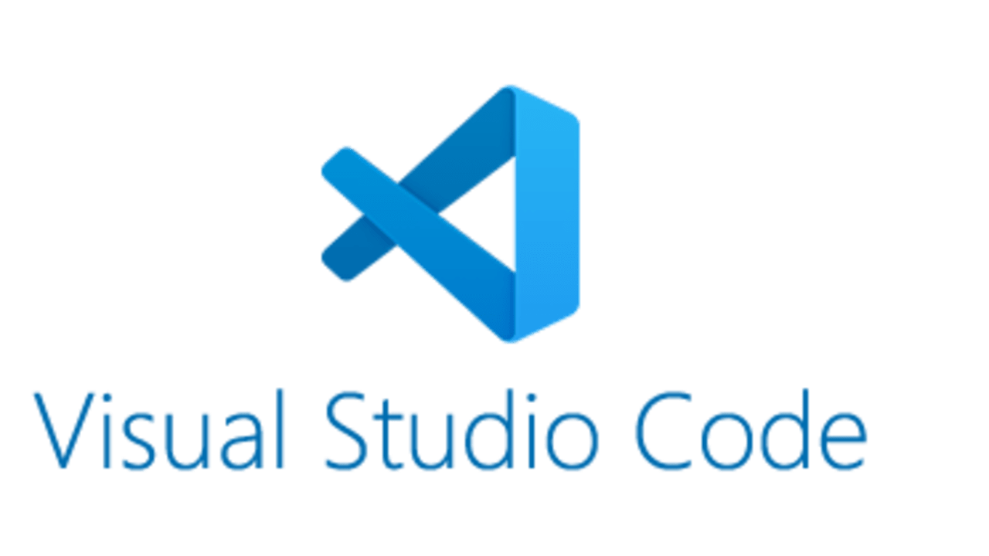
IDE
An integrated development environment (IDE) is a software application that provides comprehensive facilities to computer programmers for software development.
Some popular IDEs, such as Sublime, Atom, NetBeans, Eclipse and VS Code.
We are gonna use Visual Studio Code yeay!
Page 05

Slide 7
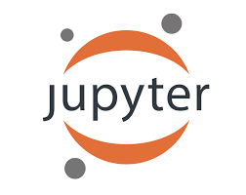
IDE
Special Python IDE best for data analysis, data visualisation and developing machine learning models.
It is a web application based on the server-client structure, and it allows you to create and manipulate notebook documents - or just “notebooks”.
You will learn how to use it for Intermediate Python.
Page 06

Slide 8
Python
Python is an interpreted, high-level and general-purpose programming language. Created by Guido van Rossum and first released in 1991.
Python’s design philosophy emphasizes code readability with its notable use of significant whitespace.
Page 07

Slide 9
Python
It is used for:
Web development(server-side)
Software development
Mathematics
System scripting
Why Python?
Python works on different platforms (Windows, Mac, Linux, Raspberry Pi, tec).
Python has a simple syntax similar to the English language.
Python has syntax that allows developers to write programs with fewer lines than some other programming languages.
Page 08

Slide 10
Python: Create Your First Program
Create file [file name].py in your folder
Write print(“Hello, World!”)
Save your file
Open terminal or command prompt
Make sure you are in the directory where your file is saved
Run program using command python [file name].py
Congratulations, you have written and executed your first Python program!
Page 09

Slide 11
Python: Comments
Comments can be used to:
Explain Python code
Make the code more readable
Prevent execution when testing code
Comments start with a #, and Python will ignore them:
# This is a comment
print("Hello, World!")
Page 10

Slide 12
Python: Variables
Variables are like containers for storing data values.
Unlike other programming languages, Python has no command for declaring variables.
x = 5
y = "Hello, World!"
print(x)
print(y)
Page 11

Slide 13
Python: Data Types
Text type : str
Number type : int, float
Boolean type : bool
Page 12

Slide 14
Python: Data Types
String: is a sequence of characters, surrounded by either single or double quotation marks.
Int: is a whole number, positive or negative, without decimals, of unlimited length.
Float: is a number, positive or negative, containing one or more decimals.
Boolean: represent one of two values of True or False.
You can get the data type of any object by using the type()
x = 5
print(type(x))
Page 13

Slide 15
Python: Math Operations
Operator | Name | Example
+ | Addition | x + y
- | Subtraction | x - y
* | Multiplication | x * y
/ | Division | x / y
% | Modulus | x % y
** | Exponentiation | x ** y
Page 14

Slide 16
Python: Castings
There may be times when you want to specify a type on to a variable.
int() - constructs an integer number from an integer literal, a float literal (by rounding down to the previous whole number), or a string literal (providing the string represents a whole number)
float() - constructs a float number from an integer literal, a float literal or a string literal (providing the string represents a float or an integer)
str() - constructs a string from a wide variety of data types, including strings, integer literals and float literals
Page 15

Slide 17
Python: Castings
x = int(2.8) # y will be 2
y = float("4.2") # w will be 4.2
z = str(3.0) # z will be '3.0'
Page 16

Slide 18

Quiz Session
Page 17

Slide 19
Quiz
Find string, integer, float, and boolean from data types below :
x = “I love AI”
y = 1945
z = 71.80
m = True
n = 2*6/3 (int or float? check in your IDE!)
Page 18

Slide 20
Terima Kasih!
Indonesia AI | AI for Everyone, AI for Indonesia
contact@aiforindonesia.org

